Slide 1
HBase Concepts

Slide 2
Components of an HBase Cluster
HBase cluster has majorly three components
  Hadoop Daemons → Storage Layer
  Zookeeper Daemons → Coordination
  HBase Daemons → Database Layer
There are three major components to HBase: the client library, one master server, and many region servers. The region servers can be added or removed while the system is up and running to accommodate changing workloads. The master is responsible for assigning regions to region servers and uses Apache Zookeeper, a reliable, highly available, persistent and distributed coordination service, to facilitate that task.
HBase run modes:
  Standalone Mode
  Distributed Mode

Slide 3
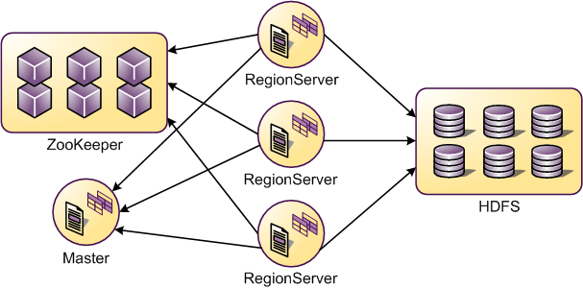
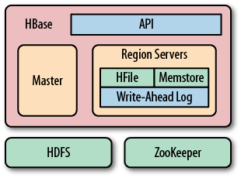
HBase Architecture

Slide 4
Building Blocks of HBase
Catalog Tables
  ROOT → keeps track of where the .META. Table
  META → The .META. table keeps a list of all regions in the system
  Startup Sequencing
    The META location is set in ROOT first. Then META is updated with server and start code values
Regions
  Regions are the basic element of availability and distribution for tables, and are comprised of a Store per Column Family. Each region is served by exactly one region server,
Table (HBase table) hierarchy of objects is as follows:
  Region (Regions for the table)
    Store (Store per Column Family for each Region for the table)
      MemStore (MemStore for each Store for each Region for the table)
      StoreFile (StoreFiles for each Store for each Region for the table)
        Block (Blocks within a StoreFile within a Store for each Region for the table)
Notes:
The basic unit of scalability and load balancing in HBase is called a region. Regions are
essentially contiguous ranges of rows stored together. They are dynamically split by
the system when they become too large. Alternatively, they may also be merged to
reduce their number and required storage files.*
The HBase regions are equivalent to range partitions as used in database
sharding. They can be spread across many physical servers, thus distributing
the load, and therefore providing scalability.

Slide 5
Contd..
Store
  A Store hosts a MemStore and 0 or more StoreFiles (HFiles). A Store corresponds to a column family for a table for a given region.
MemStore
  The MemStore holds in-memory modifications to the Store. Modifications are Key Values. When asked to flush, current MemStore is moved to snapshot and is cleared. HBase continues to serve edits out of new MemStore and backing snapshot until flusher reports in that the flush succeeded.
StoreFile (HFile)
  StoreFiles are where your data lives
  All columns in a column family are stored together in the same low level storage file
Blocks
  StoreFiles are composed of blocks. The block size is configured on a per-Column Family basis.
  Compression happens at the block level within StoreFiles
KeyValue
  The KeyValue class is the heart of data storage in HBase. KeyValue wraps a byte array and takes offsets and lengths into passed array at where to start interpreting the content as KeyValue.

Slide 6
Flush and Compaction
Flush:
HBase uses an in memory store to buffer values before writing them to disk as a new storage file in an operation called flush
HBase has mechanism to flush memstores to disk, it creates HFiles
Compaction:
HBase has a housekeeping mechanism that merges the files into larger ones using compaction.
There are two types of compaction: minor compactions and major compactions.
Minor one reduce the number of storage files by rewriting smaller files into fewer but larger ones, performing an n-way merge.
The major compactions rewrite all files within a column family for a region into a single new one.

Slide 7
Other Concepts
Region-RegionServer Locality
  Region-RegionServer locality is achieved via HDFS block replication. The HDFS client does the following by default when choosing locations to write replicas:
    First replica is written to local node
    Second replica is written to another node in same rack
    Third replica is written to a node in another rack (if sufficient nodes)
  HBase eventually achieves locality for a region after a flush or a compaction. In a RegionServer failover situation a RegionServer may be assigned regions with non-local StoreFiles (because none of the replicas are local), however as new data is written in the region, or the table is compacted and StoreFiles are re-written, they will become "local" to the RegionServer
Region Splits
  Splits run unaided on the RegionServer; i.e. the Master does not participate. The RegionServer splits a region, offlines the split region and then adds the daughter regions to META, opens daughters on the parent's hosting RegionServer and then reports the split to the Master.

Slide 8
Contd..
Online Region Merges
  Both Master and RegionServer participate in the event of online region merges. Client sends merge RPC to master, then master moves the regions together to the same RegionServer where the more heavily loaded region resided, finally master send merge request to this RegionServer and RegionServer run the region merges.
Reverse Timestamps
  A common problem in database processing is quickly finding the most recent version of a value. A technique using reverse timestamps as a part of the key can help greatly with a special case of this problem
Write Ahead Log (WAL)
  Def: In a system using WAL, all modifications are written to a log before they are applied. Usually both redo and undo information is stored in the log
  Each RegionServer adds updates (Puts, Deletes) to its write-ahead log (WAL) first, and then to MemStore for the affected Store. This ensures that HBase has durable writes. Without WAL, there is the possibility of data loss in the case of a RegionServer failure before each MemStore is flushed and new StoreFiles are written. HLog is the HBase WAL implementation, and there is one HLog instance per RegionServer.

